Slide 1
ENDER’S GAME
FINAL REVIEW

Slide 2
Chapter Study Guide Questions: Chapter 12 & 13
Study Guide Questions Chapter 12:
5. Where do Bonzo and his henchmen corner Ender? In the shower
10. To what school has Ender been assigned? Command School
Study Guide Questions Chapter 13:
8. Who will accompany Ender to Command School? Colonel Graff
10. What do buggers look like? Earth’s ants
11. What is an ansible? Philotic Parallax Instantaneous Communicator (It is able to communicate across light-years instantaneously)

Slide 3
Study Guide – Chapter 14
Ender realizes that the battleroom was to Battle School what the battle simulator is to what? Command School
Who is the old man who sits in Ender’s room one morning? Mazer Rackham
Why is Mazer Rackham still alive? N/A (Did not read this part of text)
What type of society structure do the buggers have? A queen is the only intelligence and she commands the workers to her will.
What is the official name of Dr. Device? Molecular Detachment Device
Who are Ender’s squadron leaders? The best students at Battle School, all the students he had learned to respect and trust.
What happened to Mazer’s wife and children while he was traveling in space? They grew old and died.
On his final exam, what does Ender command his troops to do? Use Dr. Device on the bugger home planet – he ordered them to blow up the planet.
What happens to Ender after he realizes he’s fought the real bugger war? He suffers a mental breakdown.

Slide 4
Study Guide – Chapter 15
What is Graff’s new job title? Minister of Colonization
Which colonist can’t Ender ignore? Valentine
What new job lies ahead for Ender? Governor of the new colony.
Why doesn’t Valentine want Ender on Earth? She doesn’t want Ender to live as Peter’s pawn.
Why is Ender going to the new colony? To learn the past of the buggers.
What job does Peter get? Hegemon of Earth.
In what place does Ender feel as though he’s been before? Where the Giant died and the End of the World scene of his nightmare.
What does Ender find behind the mirror? The last remaining bugger queen’s cocoon.
How does Ender sign his books? Speaker for the Dead.
Where do Valentine and Ender go at the end of the book? They travel from world to world while Ender looks for the bugger queen a new home.

Slide 5



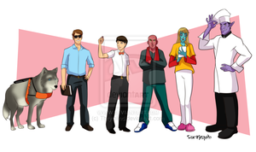
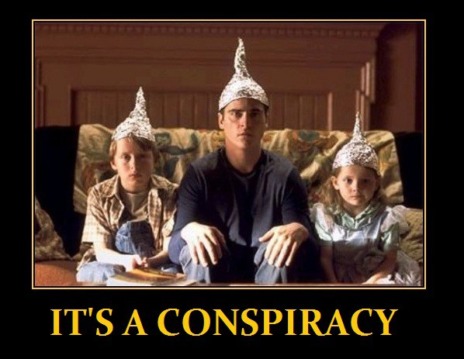

Ender’s Game Vocabulary: Chapter 12
acknowledge: to accept or admit the existence or truth of
assurance: a positive declaration intended to give confidence
civilians: a person not in the armed services or police force.
conspiracy: a secret plan by a group to do something harmful
coincidence: a remarkable concurrence of events
facilities: space or equipment necessary for doing something

Slide 6






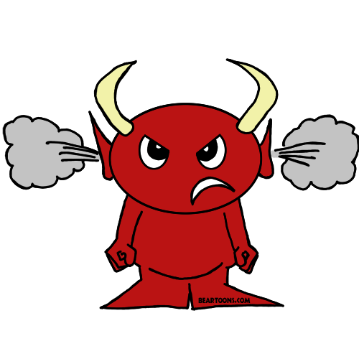

Ender’s Game Vocabulary: Chapter 13
affectionate: feeling or showing fondness or tenderness
censor: suppression of any material based on obscenity, political acceptance or threat of security
correspondence: communication by exchanging dialog with someone
diplomatically: done in a way to manage international relations to avoid offending others
hostile: unfriendly, antagonistic
infuriated: the state of being extremely angry or impatient
pacific: peaceful in character or intent
scum: a low, vile, or worthless person or group of people

Slide 7


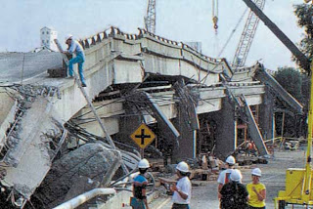
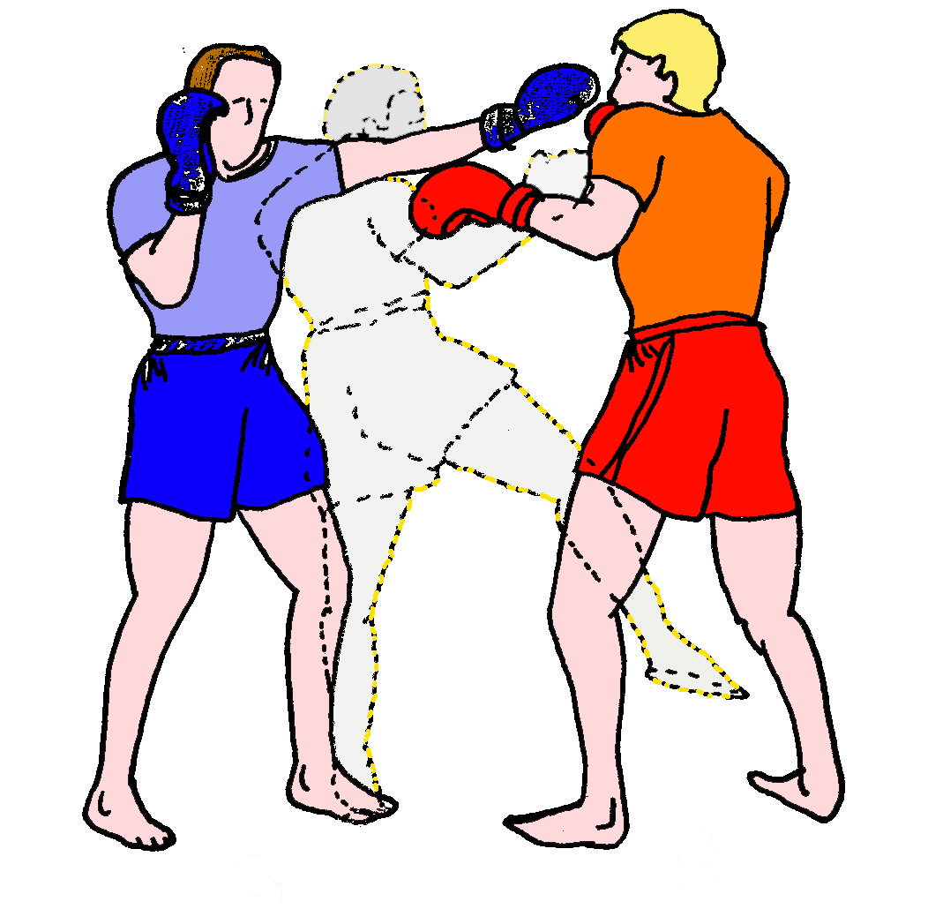






Ender’s Game Vocabulary: Chapter 14
assault: (v.) make a physical attack on; (n.) a physical attack
circumference: the distance around something
collapsed: having fallen down or in
feinting: making a deceptive or distracting movement
installations: structure or machinery placed in position or connected for use
lingering: lasting for a long time or slow to end
morale: the mental and emotional condition of an individual or group with regard to the function or tasks at hand
salvage: rescue from loss
supervised: being watched over by someone with the interests of keeping safety and security
vigorous: strong, healthy, and full of energy

Slide 8

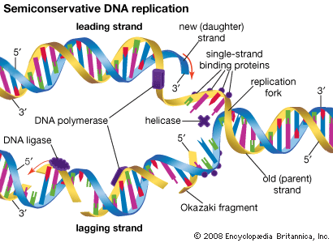


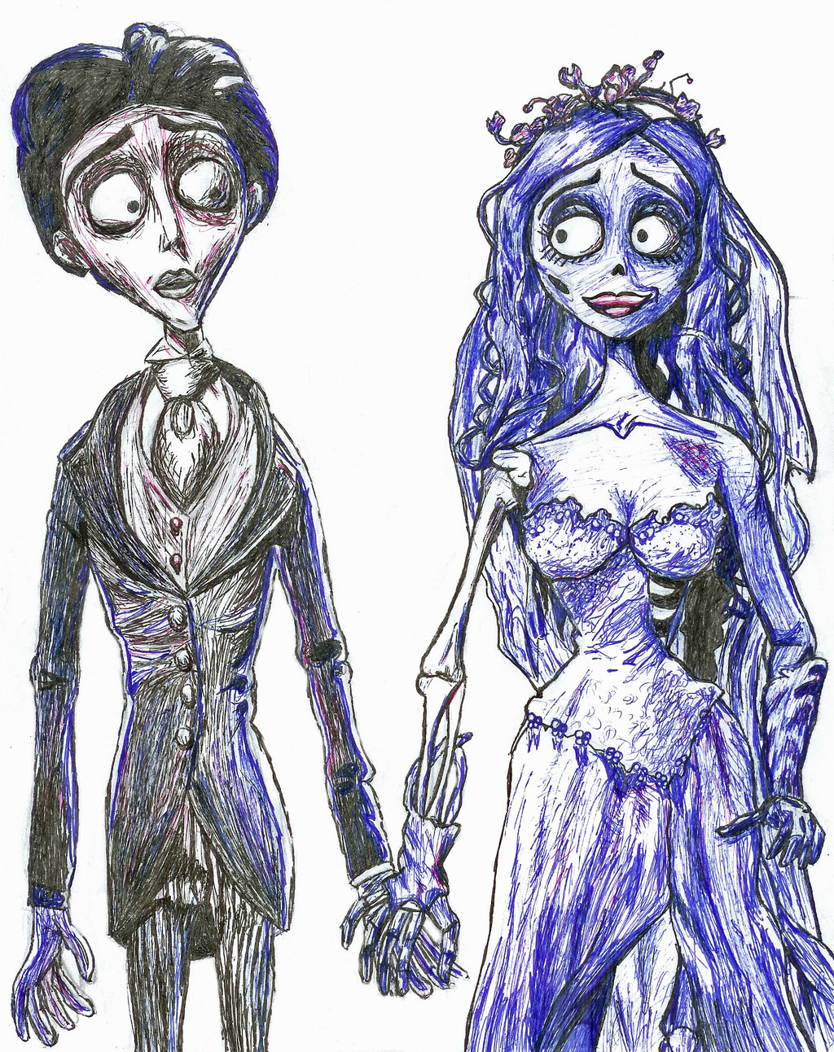

Ender’s Game Vocabulary: Chapter 15
anticipated: expected or predicted
carcass: the dead body of an animal
corpses: the dead body of a human being
duplication: the action or process of making a copy of something
homicide: deliberate and unlawful killing of one person by another; murder
prosecution: the institution conducting legal proceedings against someone in respect to a criminal charge

Slide 9
How does Ender show understanding, empathy, and compassion toward the buggers?

Slide 10
How does Ender show understanding, empathy, and compassion toward the buggers?
He promises the hive queen he will carry her world to world until he finds a world she can be brought back to life and colonize a new planet.

Slide 11
Does Ender vs. the buggers represent the theme “Good vs. Evil”? Why or why not?

Slide 12
Does Ender vs. the buggers represent the theme “Good vs. Evil”? Why or why not?
No, because the buggers are not evil. They were looking to colonize and, since they and humans were unable to communicate, did not think humans were intelligent, so began killing humans similar to how we would clear out a roach infestation.

Slide 13
How does Ender feel about his enemy once he knows he can destroy them?

Slide 14
How does Ender feel about his enemy once he knows he can destroy them?
Once he understands his enemy well enough to destroy them, in that moment he also loves them.)

Slide 15
How are the Wiggin children similar?

Slide 16
How are the Wiggin children similar?
They are all child geniuses.

Slide 17
How did Bonzo holding Ender back from battle affect Ender as a soldier?

Slide 18
How did Bonzo holding Ender back from battle affect Ender as a soldier?
It kept Ender from learning and growing as a soldier in how to maneuver in battle, but it also allowed Ender to study Bonzo’s strategies as a commander.

Slide 19
How did Ender defeat the Giant in the fantasy game?

Slide 20
How did Ender defeat the Giant in the fantasy game?
He kicked over the glasses and burrowed into the Giant’s eye socket.

Slide 21
What did Valentine do to convince Ender to continue in the Battle School program?

Slide 22
What did Valentine do to convince Ender to continue in the Battle School program?
She wrote Ender a letter and reminded him he was nothing like Peter, and even though he was excellent at defeating his enemy he was not cruel.

Slide 23
How was the environment in which Bean first met Ender changed in the movie?

Slide 24
How was the environment in which Bean first met Ender changed in the movie?
Bean was introduced at the beginning of the movie as part of Ender’s launch group rather than as a new Launchy assigned to Ender when he took command of Dragon Army.

Slide 25
How was the environment in which Dink first met Ender changed in the movie?

Slide 26
How was the environment in which Dink first met Ender changed in the movie?
Dink was placed as a toon leader in Salamander Army under Bonzo rather than Rat Army’s elite unit toon leader under Rose de Nose.

Slide 27
How would you summarize Valentine’s involvement in the war?

Slide 28
How would you summarize Valentine’s involvement in the war?
Valentine helped the I.F. writing Ender a letter and visiting with him at the cabin on Earth, as well as helped Peter organize politics back on Earth through her pseudonym, Demothenes.)

Slide 29
Identify which event in the book is left out of the movie that helps the reader understand Ender’s relationship with Bernard.

Slide 30
Identify which event in the book is left out of the movie that helps the reader understand Ender’s relationship with Bernard.
The Launchy hitting Ender repeatedly on the head and Ender accidently breaking the boy’s arm when he retaliated in order to get the boy to quit.

Slide 31
Summarize the plotline for the conflict with Bonzo:

Slide 32
Summarize the plotline for the conflict with Bonzo:
Ender is transferred to Salamander Army. Bonzo tells Ender he cannot practice with his launch group during free play. Ender disobeys Bonzo and saves their army from defeat. Ender is given command of Dragon Army. Ender defeats Bonzo in battle. Bonzo attacks Ender in the bathroom. Ender defeats Bonzo in hand to hand combat.

Slide 33
Summarize the plotline for the conflict with Stilson:

Slide 34
Summarize the plotline for the conflict with Stilson:
Ender gets his monitor removed. Stilson’s gang corners Ender into a fight. Ender kicks Stilson while he’s down. Ender tells Stilson’s gang, “Just remember what I do to people who try to hurt me.” Ender cries.

Slide 35
What important information does the reader learn during the conversation between Graff and Ender at the end of Chapter 13 that is left out of the movie?

Slide 36
What important information does the reader learn during the conversation between Graff and Ender at the end of Chapter 13 that is left out of the movie?
The reader learned that the buggers communicate telepathically and that the entire war has been caused because the two species cannot communicate with each other.

Slide 37
What are the three different locations the story takes place, and Ender’s position at each location?

Slide 38
What are the three different locations the story takes place, and Ender’s position at each location?
Earth – Student
Battle School – Soldier
Eros - Commander

Slide 39
What happened to Bernard on the launch ship?

Slide 40
What happened to Bernard on the launch ship?
Ender broke his arm because he was repeatedly hitting Ender on the head

Slide 41
What involvement did Valentine and Peter have in the war?

Slide 42
What involvement did Valentine and Peter’s have in the war?
Peter and Valentine have taken on pseudonyms of Locke and Demosthenes to sway opinion in order to prepare for the political fallout after the bugger war.

Slide 43
Create a theme statement that represents how games are important in the story.

Slide 44
Create a theme statement that represents how games are important in the story.
Games can be a healthy outlet for violent behavior.
Games can cloud our judgement of reality.
Games can be used as a way to introduce, build, or perfect real-world skills.

Slide 45
What them represents Ender’s relationships with Stilson and Bonzo?

Slide 46
What them represents Ender’s relationships with Stilson and Bonzo?
Brains vs. Brawn – The strong may always survive, but the clever will always thrive.

Slide 47
What would likely have changed if the humans and buggers could talk with one another?

Slide 48
What would likely have changed if the humans and buggers could talk with one another?
The buggers would have known the humans were intelligent and not tried to colonize their planet.)

Slide 49
Which major event from the story develops the theme statement “Communication is the key to resolution.”?

Slide 50
Which major event from the story develops the theme statement “Communication is the key to resolution.”?
Graff reveals to Ender the reason humans and buggers are at war is because they can’t talk to each other.

Slide 51
How would you summarize Mazer Rackham’s relationship with Ender?

Slide 52
How would you summarize Mazer Rackham’s relationship with Ender?
Rackham is the hero from the 2nd Formic Invasion and has been time-sustained in light speed to secretively help Ender strategize against the buggers during the actual 3rd Invasion against the bugger home world. Rackham convinces Ender he has programed simulated battle situations in order to bring him along in his training, when in actuality, he has Ender fighting the 3rd Invasion with every new battle.

Slide 53
Why did Bonzo corner and fight Ender in the bathroom?

Slide 54
Why did Bonzo corner and fight Ender in the bathroom?
Bonzo was angry with Ender for winning the battle against Salamander and using Dragon’s smallest soldier to point out his faults as a commander.

Slide 55
How does Ender represent the theme “Don’t judge a book by its cover.”?

Slide 56
How does Ender represent the theme “Don’t judge a book by its cover.”?
Ender is a scrawny 6-year-old super-genius strategist and tactician.

Slide 57
Who did Ender get into a fight with after having his monitor removed?

Slide 58
Who did Ender get into a fight with after having his monitor removed?
Stilson and his gang.

Slide 59
Throughout the book the authority figures (I.F. and instructors/teachers) manipulate Ender. At Command School Ender is tested on his ability to command by playing in mock battles against the buggers. How was this another manipulation by the authority figures, and how might the story have changed if Ender were aware of this manipulation beforehand.

